Slide 1
Event Handling
With event-driven programming, events are detected by a program and handled appropriately
Events: moving the mouse clicking the button pressing a key sliding the scrollbar thumb choosing an item from a menu

Slide 2
Three Steps of Event Handling
Prepare to accept events import package java.awt.event
Start listening for events include appropriate methods
Respond to events implement appropriate abstract method

Slide 3
1. Prepare to accept events
Import package java.awt.event
Applet manifests its desire to accept events by promising to “implement” certain methods
Example: “ActionListener” for Button events “AdjustmentListener” for Scrollbar events

Slide 4
2. Start listening for events
To make the applet “listen” to a particular event, include the appropriate “addxxxListener”.
Examples: addActionListener(this) shows that the applet is interested in listening to events generated by the pushing of a certain button.

Slide 5
2. Start listening for events (cont)
Example addAdjustmentListener(this) shows that the applet is interested in listening to events generated by the sliding of a certain scroll bar thumb.
“this” refers to the applet itself - “me” in English

Slide 6
3. Respond to events
The appropriate abstract methods are implemented.
Example: actionPerformed() is automatically called whenever the user clicks the button. Thus, implement actionPerformed() to respond to the button event.

Slide 7
3. Respond to events (cont)
Example: adjustmentValueChanged() is automatically invoked whenever the user slides the scroll bar thumb. So adjustmentValueChanged() needs to be implemented.
In actionPerformed(ActionEvent evt), ActionEvent is a class in java.awt.event.

Slide 8
StatBar
pan2
statement
north
center
ranger
south
leftMsg
centerValue
rightMsg
pan1
pan3

Slide 9
EVENT HANDLING

Slide 10
DELEGATION EVENT MODEL
This model defines standard and consistent mechanisms to generate and process events.
Its concept is :
A source generates an event and sends it to one or more listeners.
The listener simply waits until it receives an event.
Once received, the listener processes the event and then returns.

Slide 11
Contd..
Listeners must register with a source in order to receive an event notification.
Notifications are sent only to listeners that want to receive them.
The advantage of this model is that the application logic that processes events is separated from the user interface logic that generates those events.

Slide 12
Events
An event is an object that describes a state change in a source.
Some of the activities that cause events to be generated are pressing a button, entering a character via the keyboard, selecting an item in a list, clicking of the mouse.

Slide 13
Event Sources
A source is an object that generates an event.
Sources may generate more than one type of event.
A source must register listeners in order for the listeners to receive notifications about a specific type of event.

Slide 14
Each type of event has its own registration method. Its general form is :
public void addTypeListener(TypeListener el)
Here, Type is the name of the event and el is a reference to the event listener.e.g., the method that registers a keyboard event listener is called addKeyListener( ).
A source also provides a method that allows a listener to unregister an interest in a specific type of event.Its general form is :
public void removeTypeListener(TypeListener el)
e.g. To remove a keyboard listener, we call removeKeyListener().

Slide 15
Event Listeners
A listener is an object that is notified when an event occurs.
It has two major requirements :
  It must be registered with one or more sources to receive notifications about specific types of events.
  It must implement methods to receive and process these notifications.

Slide 16
Contd..
The methods that receive and process events are defined in a set of interfaces found in java.awt.event. e.g., the MouseMotionListener interface defines two methods to receive notifications when the mouse is dragged or moved.

Slide 17
Event Classes
EventObject which is in java.util is a superclass of all the events.
AWTEvent which is in java.awt package is a superclass of all AWT events that are handled by the delegation model.

Slide 18
The package java.awt.event defines several types of events that are generated by various user interface elements.
Event Class | Description
ActionEvent | Generated when a button is pressed, a list item is double-clicked, or a menu item is selected.
AdjustmentEvent | Generated when a scrollbar is manipulated.
ComponentEvent | Generated when a component is hidden, moved, resized or becomes visible.

Slide 19
Event Class | Description
ContainerEvent | Generated when a component is added to or removed from a container.
FocusEvent | Generated when a component gains or loses keyboard focus.
ItemEvent | Generated when a checkbox or list item is clicked; also occurs when a choice selection is made or a checkable menu item is selected or deselected.

Slide 20
Event Class | Description
KeyEvent | Generated when input is received from the keyboard.
MouseEvent | Generated when the mouse is dragged, moved, clicked, pressed, or released; also generated when the mouse enters or exits a component.
TextEvent | Generated when the value of a text area or text field is changed.
WindowEvent | Generated when a window is activated, deactivated, opened, or closed.

Slide 21
How to Implement an Event Handler
Every event handler requires three bits of code:
In the declaration for the event handler class, code that specifies that the class either implements a listener interface or extends a class that implements a listener interface. For example:
public class MyClass implements ActionListener {
Code that registers an instance of the event handler class as a listener upon one or more components. For example: someComponent.addActionListener(instanceOfMyClass);
Code that implements the methods in the listener interface. For example:
public void actionPerformed(ActionEvent e) { ...//code that reacts to the action... }

Slide 22
Let's investigate a typical event-handling scenario by looking at how buttons handle mouse clicks.
To detect when the user clicks an on-screen button, a program must have an object that implements the ActionListener interface. The program must register this object as an action listener on the button (the event source), using the addActionListener method.
When the user clicks the on-screen button, the button fires an action event. This results in the invocation of the action listener's actionPerformed method (the only method in the ActionListener interface). The single argument to the method is an ActionEvent object that gives information about the event and its source.

Slide 23
//Button Handling
import java.awt.*;
import java.awt.event.*;
import java.applet.*;
public class ButtonTest extends Applet
implements ActionListener {
Button button;
String s=null;
public void init() {
button = new Button("Click Me");
add(button);
button.addActionListener(this);
}
public void actionPerformed(ActionEvent e) {
s= e.getActionCommand();
System.out.println(s);
}
}

Slide 24
The ButtonTest class implements the ActionListener interface, which contains one method: actionPerformed.
Since ButtonTest implements ActionListener, a ButtonTest object can register as a listener for the action events that buttons fire.
Once the ButtonTest has been registered using the Button addActionListener method, the ButtonTest 's actionPerformed method is called every time the button is clicked.

Slide 25
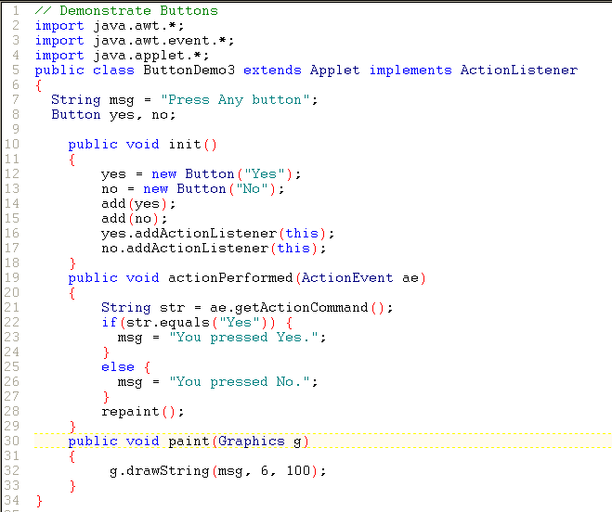

Slide 26
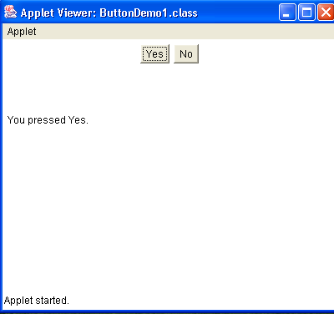

Slide 27
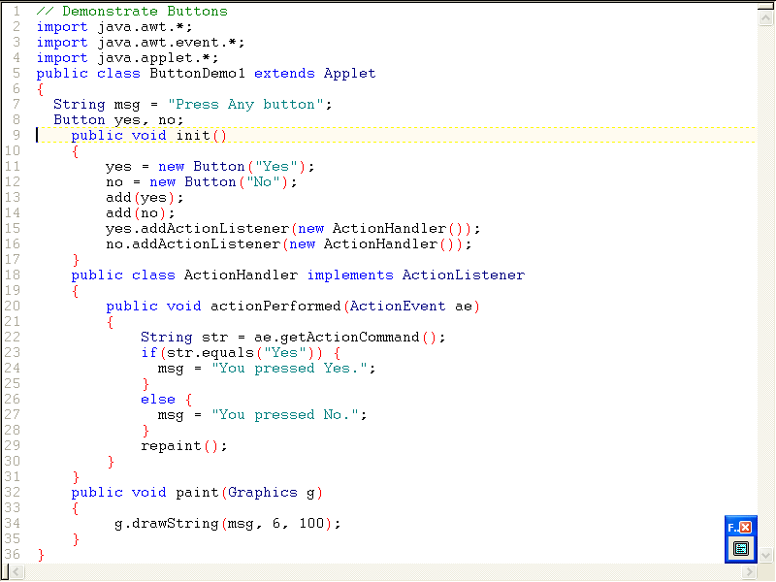

Slide 28
Event Listener Interfaces
ActionListener Interface
public interface ActionListener extends EventListener
The listener interface for receiving action events. The class that is interested in processing an action event implements this interface, and the object created with that class is registered with a component, using the component's addActionListener method. When the action event occurs, that object's actionPerformed() method is invoked.

Slide 29
public void actionPerformed(ActionEvent e)
  Invoked when an action occurs.

Slide 30
KeyListener Interface
public interface KeyListener extends EventListener
The listener interface for receiving keyboard events (keystrokes).
The class that is interested in processing a keyboard event either implements this interface (and all the methods it contains) or extends the abstract KeyAdapter class (overriding only the methods of interest).
The listener object created from that class is then registered with a component using the component's addKeyListener() method.

Slide 31
Contd..
A keyboard event is generated when a key is pressed, released, or typed (pressed and released). The relevant method in the listener object is then invoked, and the KeyEvent is passed to it.
Methods:
public void keyTyped(KeyEvent e)
  Invoked when a key has been typed. This event occurs when a key press is followed by a key release.

Slide 32
Contd..
public void keyPressed(KeyEvent e)
  Invoked when a key has been pressed.
public void keyReleased(KeyEvent e)
  Invoked when a key has been released.

Slide 33
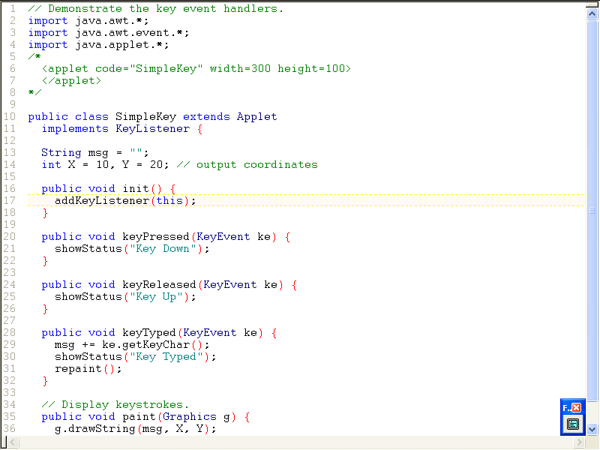

Slide 34
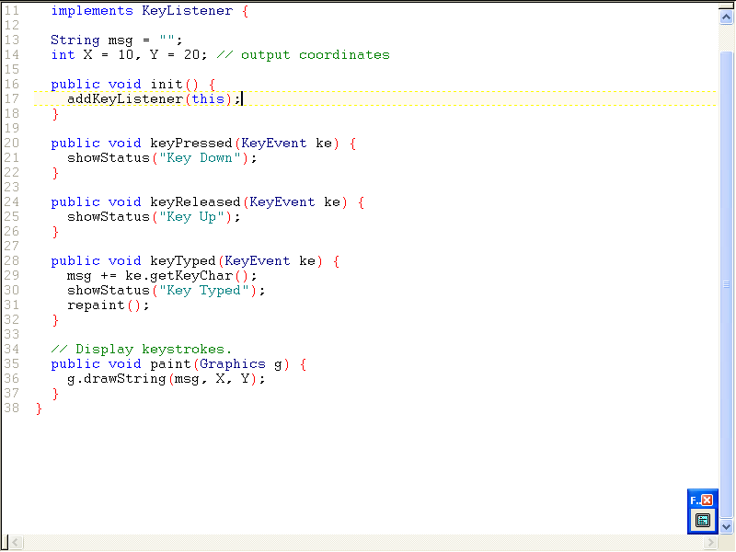

Slide 35
MouseListener
public interface MouseListener extends EventListener
The listener interface for receiving "interesting" mouse events (press, release, click, enter, and exit) on a component. (To track mouse moves and mouse drags, use the MouseMotionListener.)
The class that is interested in processing a mouse event either implements this interface (and all the methods it contains) or extends the abstract MouseAdapter class (overriding only the methods of interest).

Slide 36
The listener object created from that class is then registered with a component using the component's addMouseListener() method.
A mouse event is generated when the mouse is pressed, released clicked (pressed and released).
A mouse event is also generated when the mouse cursor enters or leaves a component. When a mouse event occurs the relevant method in the listener object is invoked, and the MouseEvent is passed to it.

Slide 37
Methods:
public void mouseClicked(MouseEvent e)
  Invoked when the mouse has been clicked on a component.
public void mousePressed(MouseEvent e)
  Invoked when a mouse button has been pressed on a component.
public void mouseReleased(MouseEvent e)
  Invoked when a mouse button has been released on a component.

Slide 38
Contd..
public void mouseEntered(MouseEvent e)
  Invoked when the mouse enters a component.
public void mouseExited(MouseEvent e)
  Invoked when the mouse exits a component.

Slide 39
MouseMotionListener Interface
public interface MouseMotionListener extends EventListener
The listener interface for receiving mouse motion events on a component. (For clicks and other mouse events, use the MouseListener.)
The class that is interested in processing a mouse motion event either implements this interface (and all the methods it contains) or extends the abstract MouseMotionAdapter class (overriding only the methods of interest).

Slide 40
Contd..
The listener object created from that class is then registered with a component using the component's addMouseMotionListener() method.
A mouse motion event is generated when the mouse is moved or dragged. (Many such events will be generated). When a mouse motion event occurs, the relevant method in the listener object is invoked, and the MouseEvent is passed to it.

Slide 41
Methods:
public void mouseDragged(MouseEvent e)
  Invoked when a mouse button is pressed on a component and then dragged. Mouse drag events will continue to be delivered to the component where the first originated until the mouse button is released (regardless of whether the mouse position is within the bounds of the component).
public void mouseMoved(MouseEvent e)
  Invoked when the mouse button has been moved on a component (with no buttons no down).

Slide 42
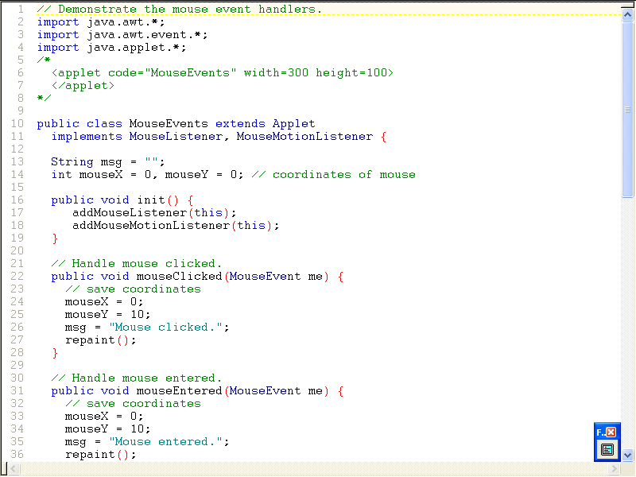

Slide 43
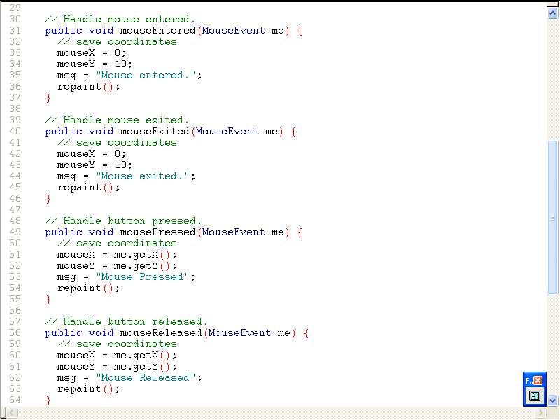

Slide 44
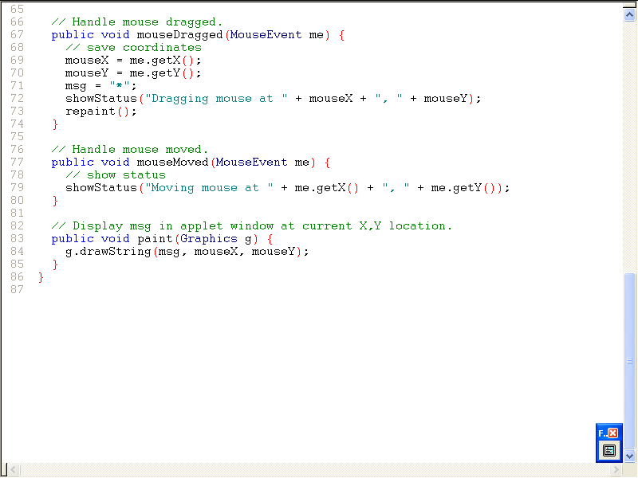

Slide 45
Adapter Class
An adapter class provides an empty implementation of all methods in an event listener interface.
Adapter classes are useful when you want to receive and process only some of the events that are handled by a particular event listener interface.
We define a new class to act as an event listener by extending one of the adapter classes and implementing only those events in which we are interested.

Slide 46
Listener Interfaces implemented by Adapter Classes
Adapter Class | Listener Interface
KeyAdapter | KeyListener
MouseAdapter | MouseListener
MouseMotionAdapter | MouseMotionListener
WindowAdapter | WindowListener
ComponentAdapter | ComponentListener
ContainerAdapter | ContainerListener
FocusAdapter | FocusListener

Slide 47
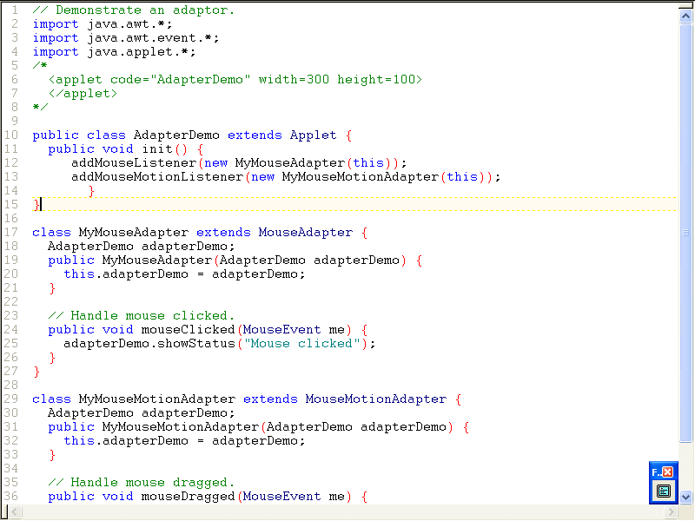

Slide 48
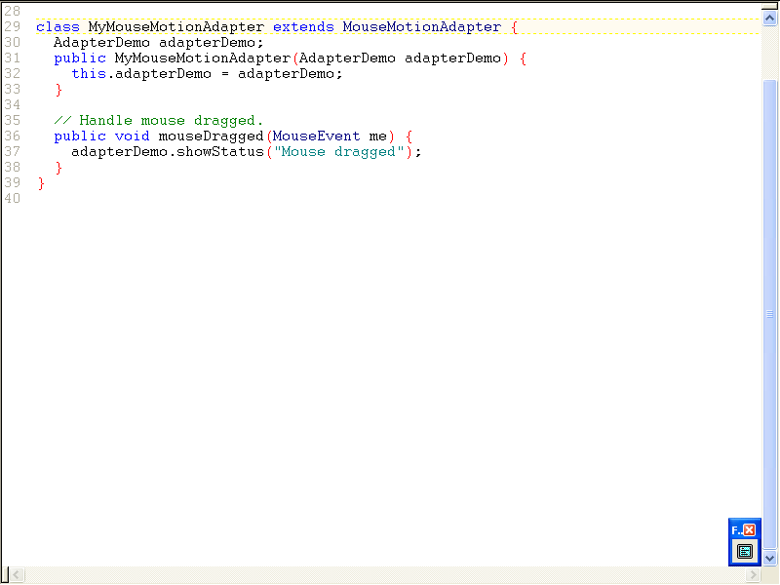

Slide 49
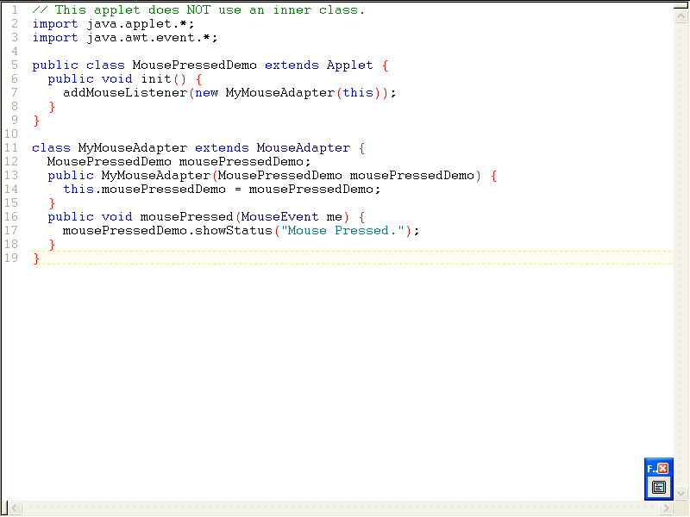

Slide 50
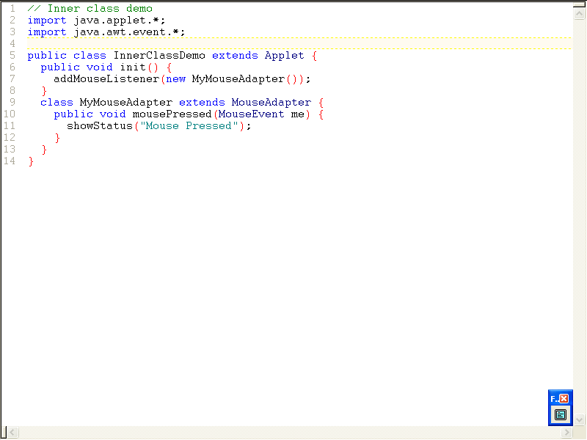

Slide 51
